Slide 1

Performance
Performance in the cloud
Latency, bandwidth, throughput
Measuring performance with apache benchmark

Slide 2

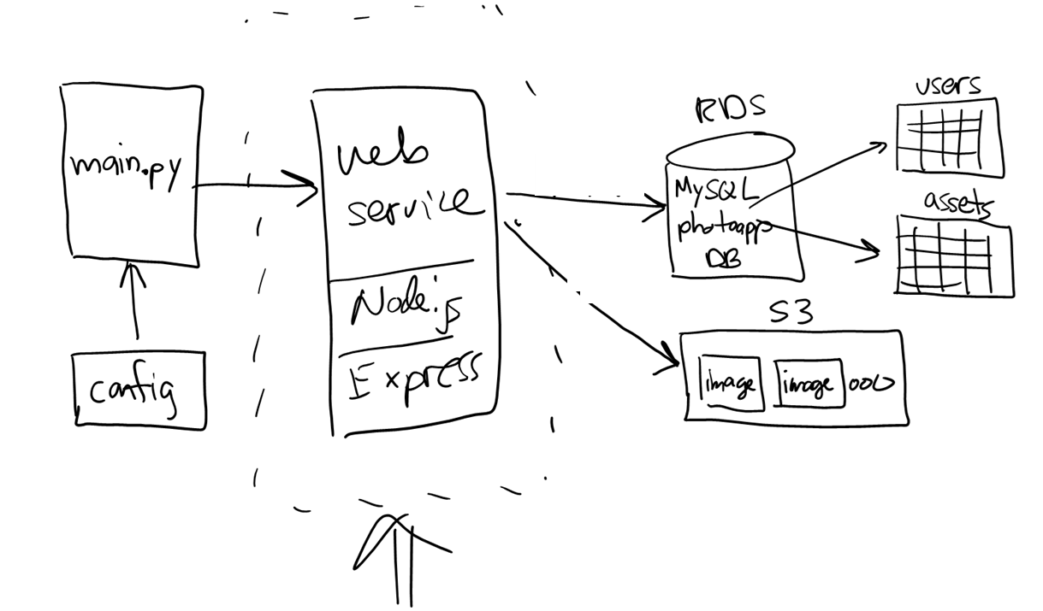
Project 02 --- photoapp web service in AWS
EC2
//
// PhotoApp web service
//
app.get('/stats', (req, res) => {…});
app.put('/user', (req, res) => {…});
app.get('/users', (req, res) => {…});
app.get('/assets', (req, res) => {…});
app.get('/bucket', (req, res) => {…});
app.get('/image/:assetid', (req, res) => {…});
app.post('/image/:userid', (req, res) => {…});
Notes:
EC2 = Elastic Compute

Slide 3
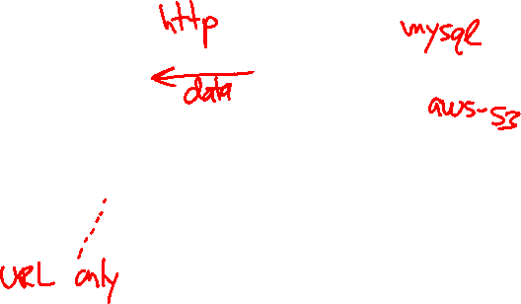
Project 02 --- photoapp web service in AWS
EC2
//
// PhotoApp web service
//
app.get('/stats', (req, res) => {…});
app.put('/user', (req, res) => {…});
app.get('/users', (req, res) => {…});
app.get('/assets', (req, res) => {…});
app.get('/bucket', (req, res) => {…});
app.get('/image/:assetid', (req, res) => {…});
app.post('/image/:userid', (req, res) => {…});
Notes:
EC2 = Elastic Compute

Slide 4
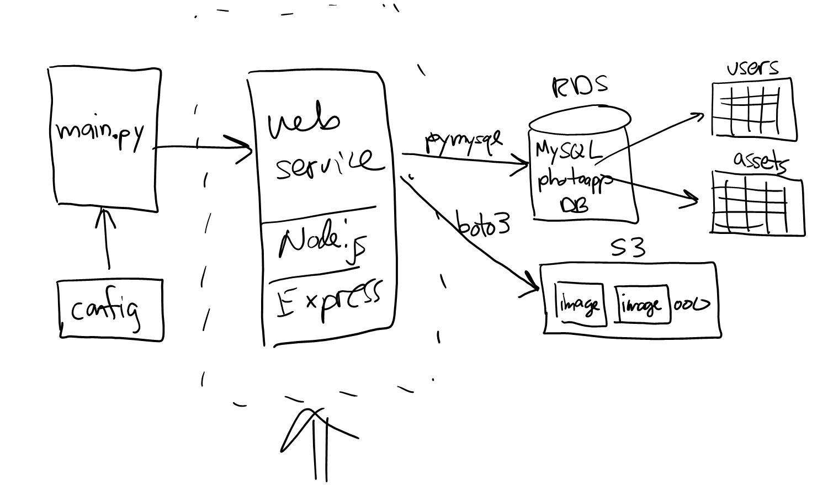
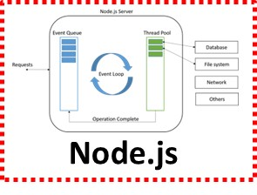
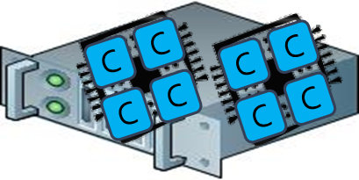
Demo
http://nu-cs-msa-s3-photoapp-web-servic-env.eba-njwcmj6i.us-east-2.elasticbeanstalk.com/stats

Slide 5
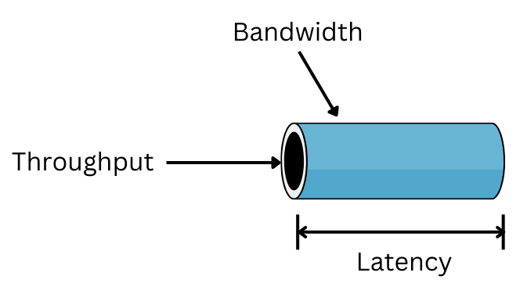
Network latency vs. bandwidth
Latency: how long does it take? (speed = response time)
Bandwidth: how much data can be transmitted? (volume)
Throughput: how much processing per time unit? (# of users)

Slide 6
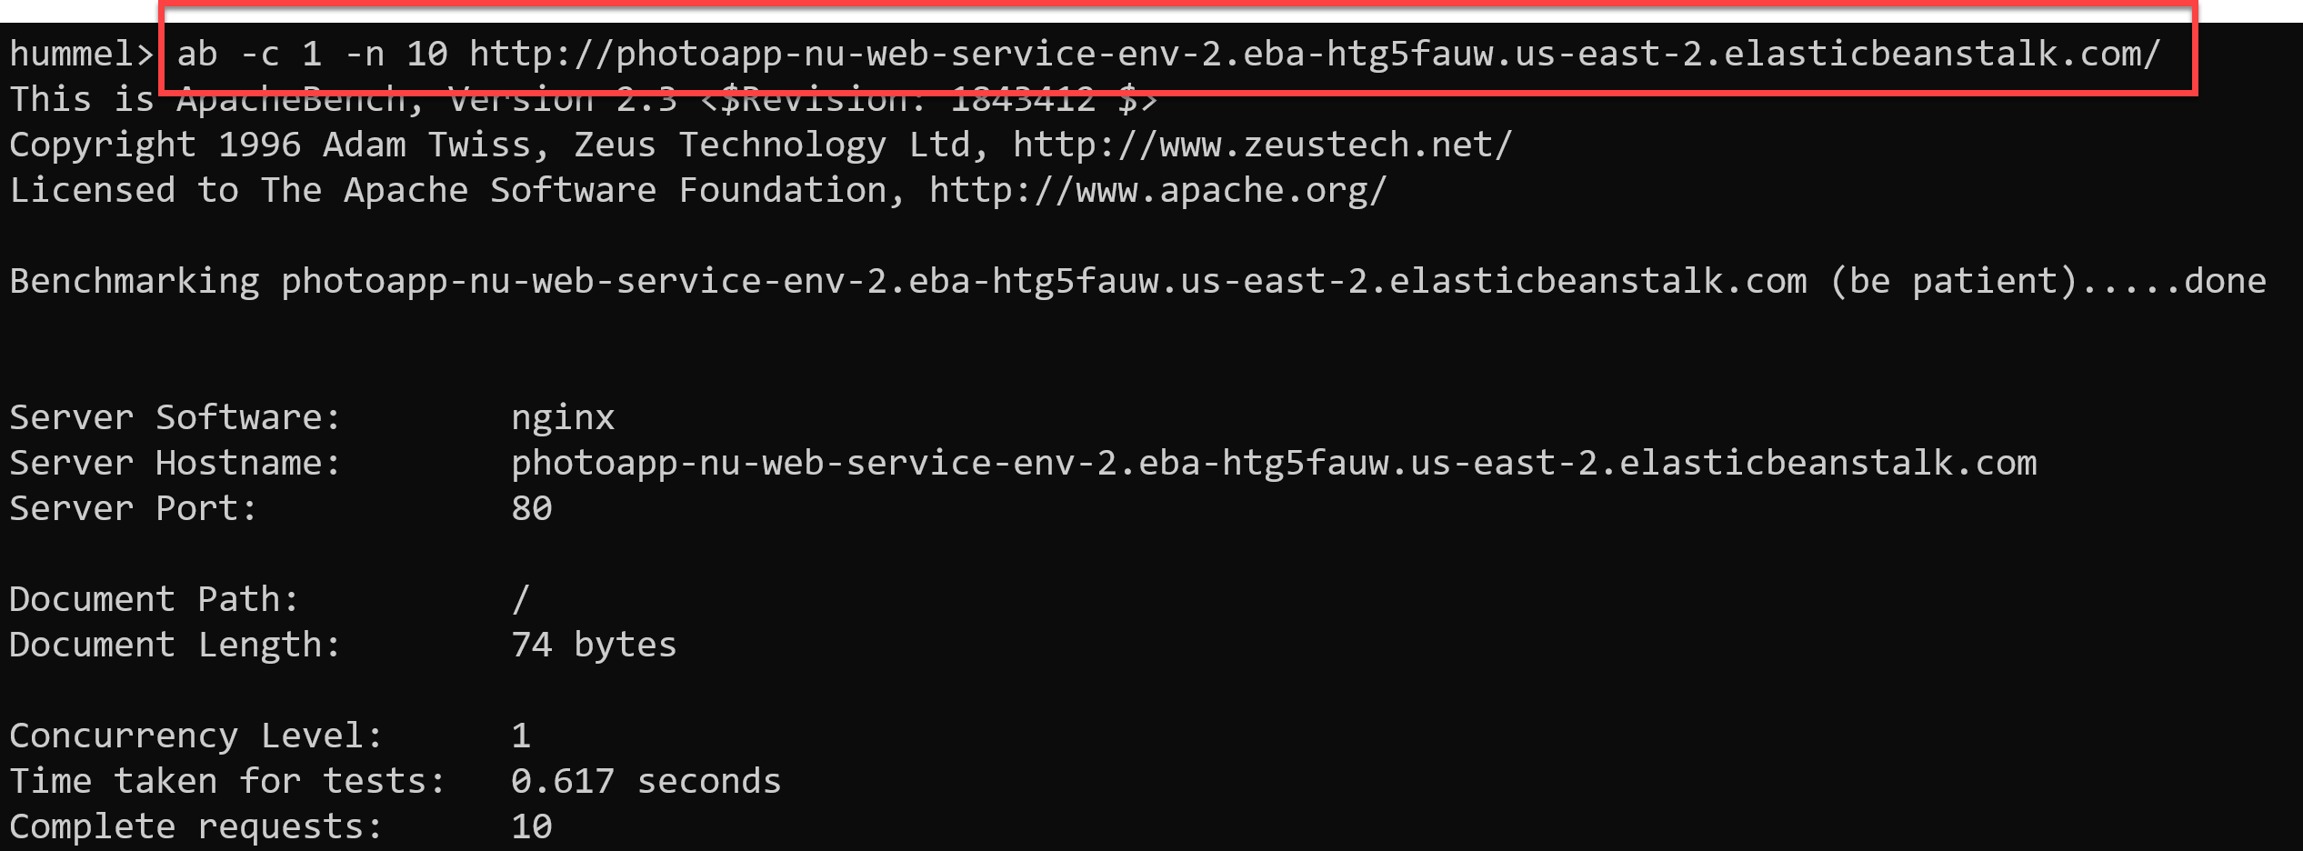
Benchmarking
Let's benchmark project 02 web service
Baseline:
cost of a round-trip with no computation
==> time to retrieve "home page"…
http://nu-cs-msa-s3-photoapp-web-servic-env.eba-njwcmj6i.us-east-2.elasticbeanstalk.com/
Notes:
Apache benchmark, freely available tool:
Reference: https://httpd.apache.org/docs/2.4/programs/ab.html
Usage: ab –k –c 10 –n 1000 URL
-c => concurrency level
-n => # of requests
-k => keep-alive the TCP connection (cold-start vs. warm-start)
Linux: sudo apt-get install apache2-tools, type ab …
Mac: open terminal, type ab …
Windows:
download full apache as .zip file: https://www.apachelounge.com/download/
open/extract contents of .zip
copy /bin/ab.exe to a local folder
open command prompt, navigate to local folder, type ab ...

Slide 7
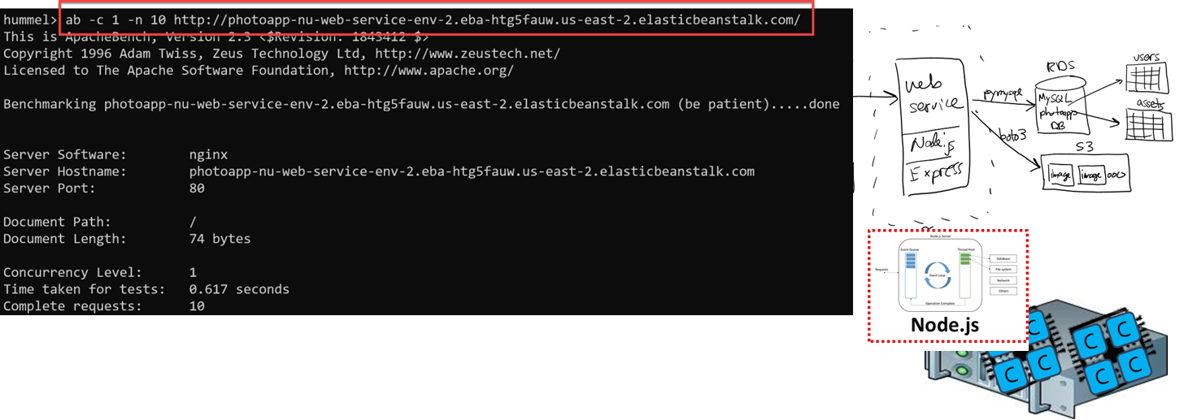
ab == apache benchmark
Reference: https://httpd.apache.org/docs/2.4/programs/ab.html
Linux: sudo apt-get install apache2-tools
Mac: already installed (terminal window)
Windows: download apache (https://www.apachelounge.com/download/), extract /bin/ab.exe
Usage: ab -k -c 10 -n 1000 URL
-k => keep-alive the TCP connection (cold-start vs. warm-start)
-c => concurrency level (use this to simulate concurrent users / load on the server)
-n => # of requests (use this to get a more accurate "average" response time)

Slide 8
Question #1
Baseline latency is _____ ms
Best guess --- which API function(s) will have fastest response time / lowest latency?
//
// PhotoApp web service
//
app.get('/stats', (req, res) => {…});
app.get('/users', (req, res) => {…});
app.get('/assets', (req, res) => {…});
app.get('/bucket', (req, res) => {…});
app.get('/image/:assetid', (req, res) => {…});
Notes:
/users and /assets only go to RDS, and /bucket only goes to S3 --- those should be the fastest / lowest latency…

Slide 9
Observations…
/users and /assets are fastest
Why? RDS is faster than S3
DB vs. Web service
Notice that /users latency is close to baseline
The trip to AWS is the largest part of the cost…
Remember to always minimize the # of trips…

Slide 10
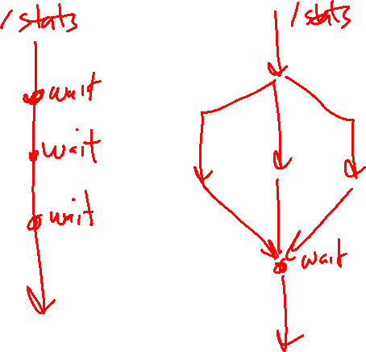
Question #2
Does async programming make a difference on the server?
Notes:
ab –c 2
ab –c 5
Etc.

Slide 11
Question #3
Let's look at bandwidth vs. latency…
Asset 1004 is 43K, asset 1014 is 1,964K --- 46x bigger
Time to download image # 1004 is ____ ms
How much longer will it take to download image # 1014? ( _____ ms )
//
// PhotoApp web service
//
app.get('/stats', (req, res) => {…});
app.get('/users', (req, res) => {…});
app.get('/assets', (req, res) => {…});
app.get('/bucket', (req, res) => {…});
app.get('/image/:assetid', (req, res) => {…});
Notes:
Even though 46x in size, only takes roughly 3x longer. Again, the cost is more about the trip itself, and less about the size of the packets being transmitted

Slide 12
Observations…
You can generally ignore payload size, and focus on minimizing the # of trips
Downloading an image doesn't take much longer than other functions
Even though #1007 is 40x larger, only takes 3x time
==> not faster to break apart and send separately

Slide 13
Question #4
Throughput…
Node.js is single-threaded and runs on one core. How many users can it support before latency suffers?
use ab -c option
//
// PhotoApp web service
//
app.get('/stats', (req, res) => {…});
app.get('/users', (req, res) => {…});
app.get('/assets', (req, res) => {…});
app.get('/bucket', (req, res) => {…});
app.get('/image/:assetid', (req, res) => {…});
Notes:
ab –c 2
ab –c 5
Etc.

Slide 14
Observations…
Definitely more than one user…
Due to asynchronous programming model
Typically 5-10 users depending on the function

Slide 15
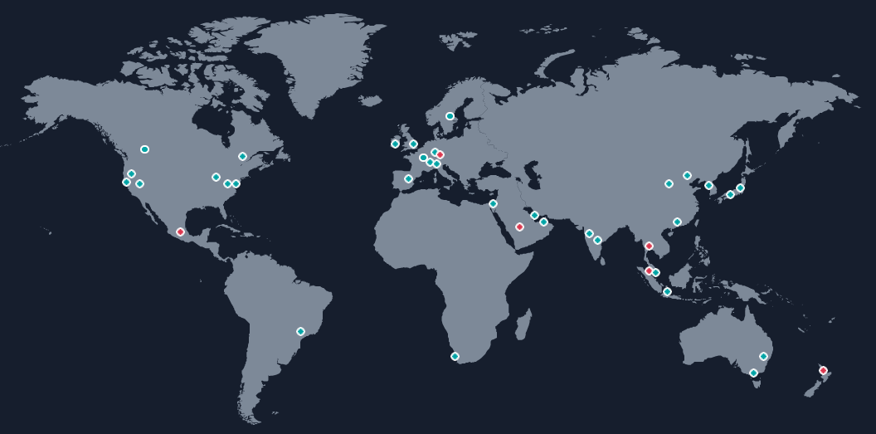
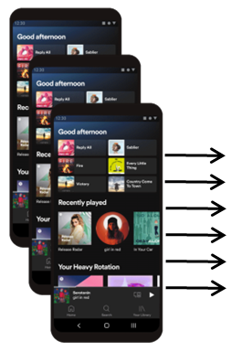
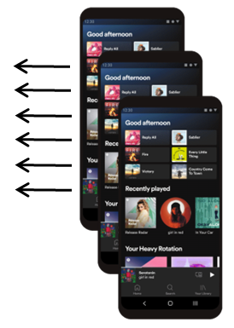
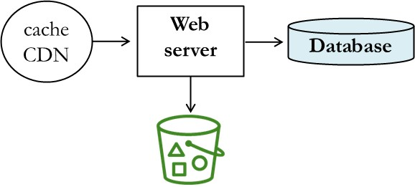
How to improve latency?
Faster internet connection or shorten the distance…
Cache data in CDN (AWS CloudFront)
Replicate in different regions (USA, Europe, Asia, Africa, …)
Notes:
Note: the machines are linked together, i.e. it's ONE database replicated across --- MySQL Cluster. And likewise it's ONE bucket replicated, which S3 supports. More discussion on that later…

Slide 16

How to improve latency?
Faster internet connection or shorten the distance…
Cache data in CDN (AWS CloudFront)
Replicate in different regions (USA, Europe, Asia, Africa, …)
Notes:
Note: the machines are linked together, i.e. it's ONE database replicated across --- MySQL Cluster. And likewise it's ONE bucket replicated, which S3 supports. More discussion on that later…

Slide 17
How to improve bandwidth?
Bandwidth is a function of the network connection
You generally don't have much control
Mobile, Wifi, hard-wired, …
All different speeds with different reliability

Slide 18

How to improve throughput (# of users)?
Vertical scaling makes your machine(s) bigger and stronger. Think more cores, RAM.
Horizontal scaling adds more machines. Think of them standing side-by-side.
Vertical scaling is easy, rent more cores / RAM
Instant scalability, but cores may sit idle most of the time (wasting $)
Horizontal scaling supports any # of users
May take a few minutes for machines to startup (some users wait)
Throughput improved by ______________
scaling
Notes:
Scaling improves throughput (# of users we can support)

Slide 19
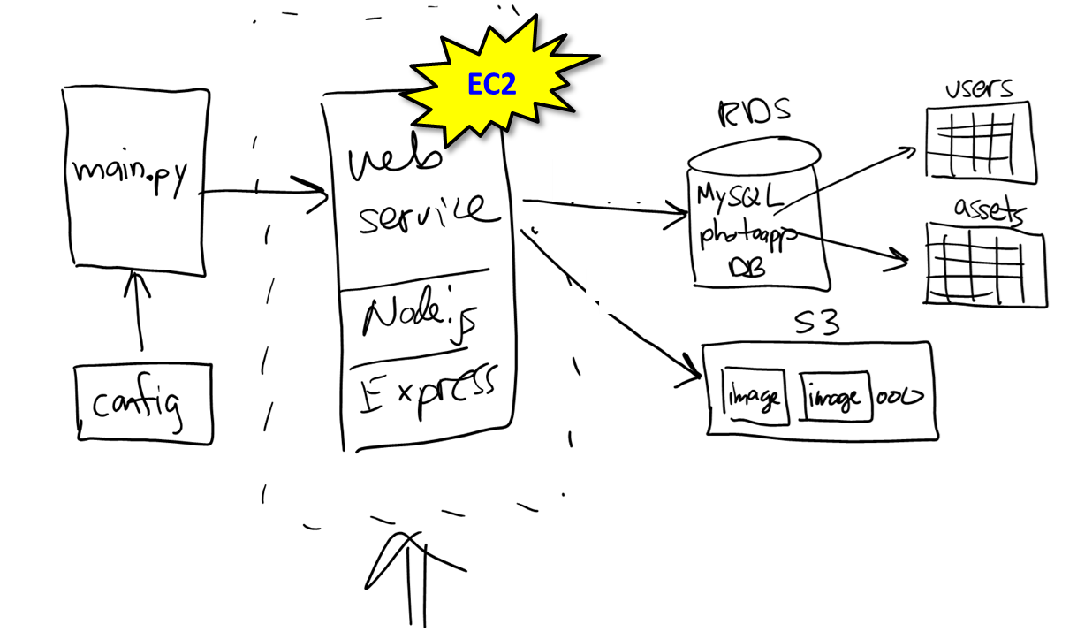
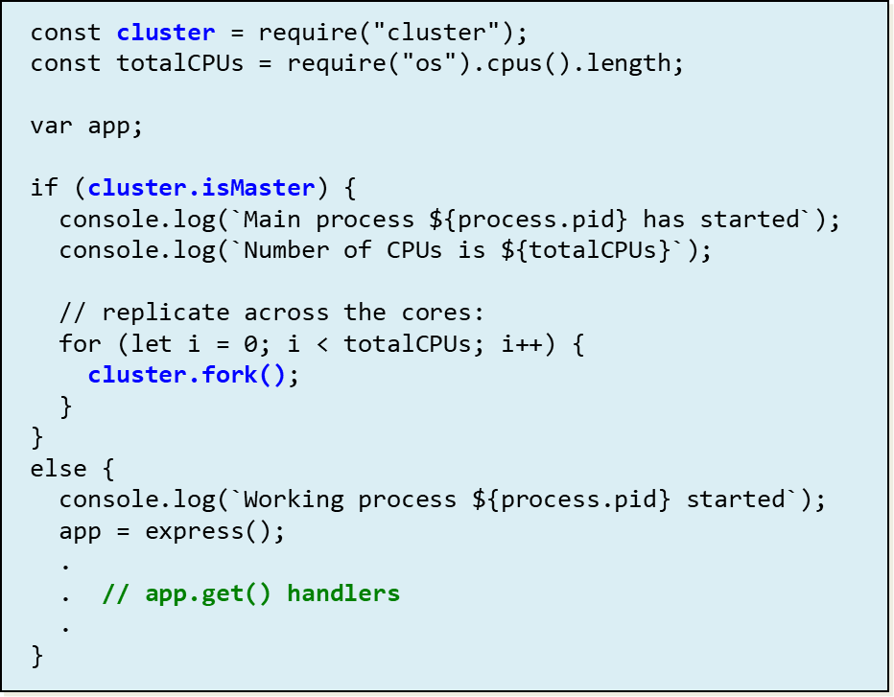
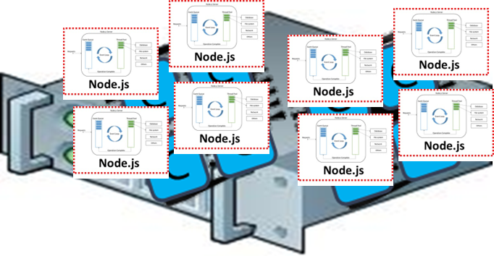
Scaling up project 02 on EB / EC2?
Rent a VM with more cores & RAM
Rewrite app.js to fork / replicate
Deploy new version
Notes:
EC2 = Elastic Compute

Slide 20
That's it, thank you!

Slide 21
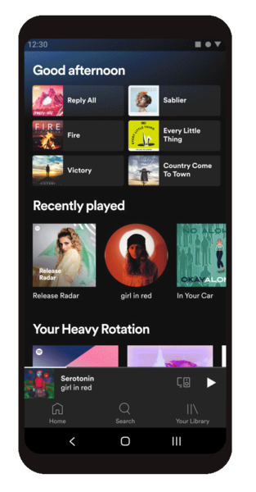

cache CDN
Web
server
Database

